Slide 1
Unit 4
By
Dr. Amit.

Slide 2
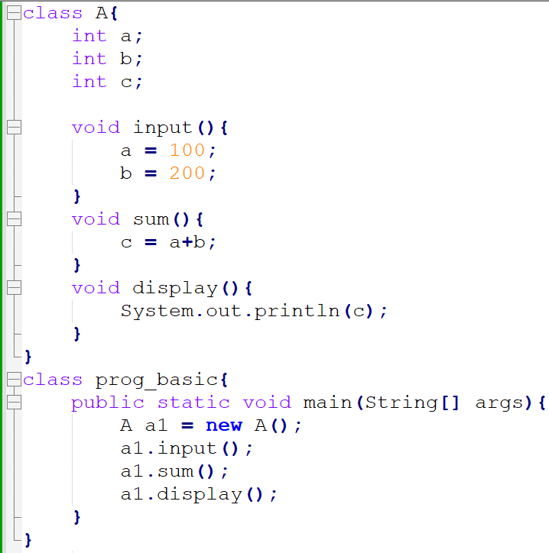

Slide 3
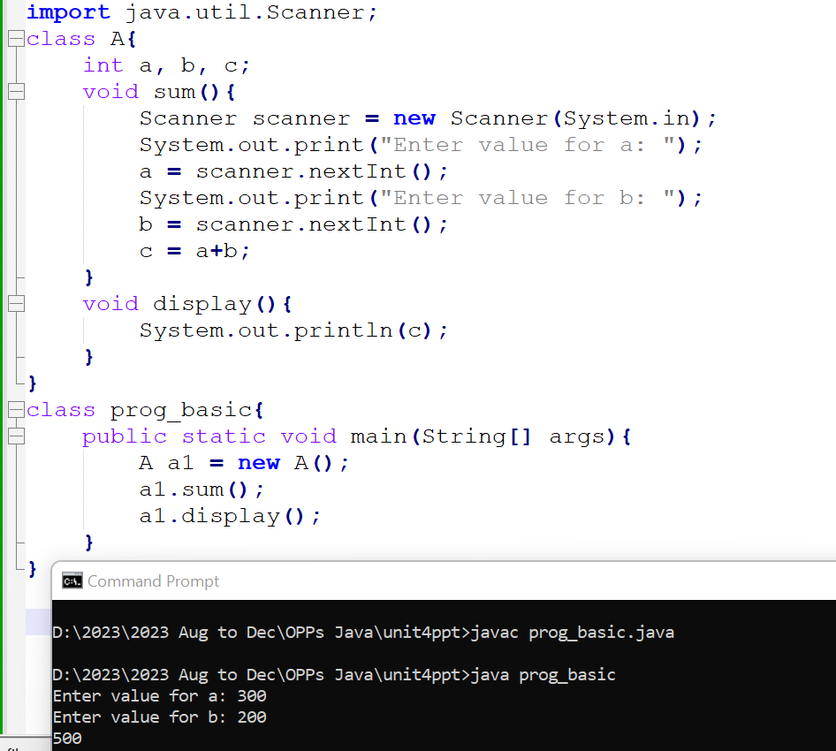

Slide 4
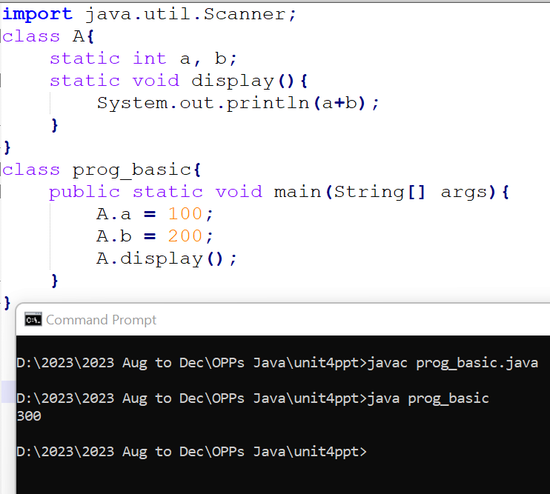

Slide 5
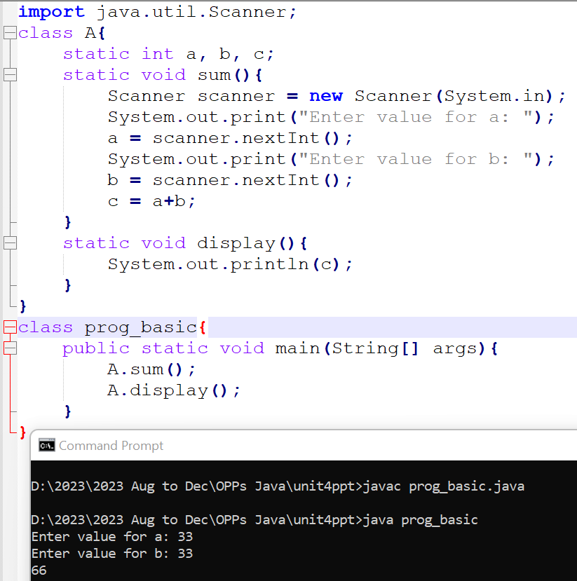

Slide 6
Nested Class
The Java programming language allows us to define a class within another class. Such a class is called a nested class.
Example:
class OuterClass
{
...
class NestedClass
{
...
}
}

Slide 7
Types of Nested Classes
A nested class is a member of its enclosing class.
Nested classes are divided into two categories:
static
non-static
Nested classes that are declared static are simply called static nested classes.
Non-static nested classes are called inner classes.

Slide 8
Why Use Nested Classes?
Logical grouping of classes—If a class is useful to only one other class, then it is logical to embed it in that class and keep the two together.
Increased encapsulation—Consider two top-level classes, A and B, where B needs access to members of A that would otherwise be declared private. By hiding class B within class A, A's members can be declared private and B can access them. In addition, B itself can be hidden from the outside world.
More readable, maintainable code

Slide 9
Static Nested Classes
A static nested class is associated with its outer class similar to class methods and variables.
A static nested class cannot refer directly to instance variables or methods defined in its enclosing class.
It can use them only through an object reference.
Static nested classes are accessed using the enclosing class name:
OuterClass.StaticNestedClass
For example, to create an object for the static nested class, use this syntax:
OuterClass.StaticNestedClass nestedObject = new OuterClass.StaticNestedClass();

Slide 10
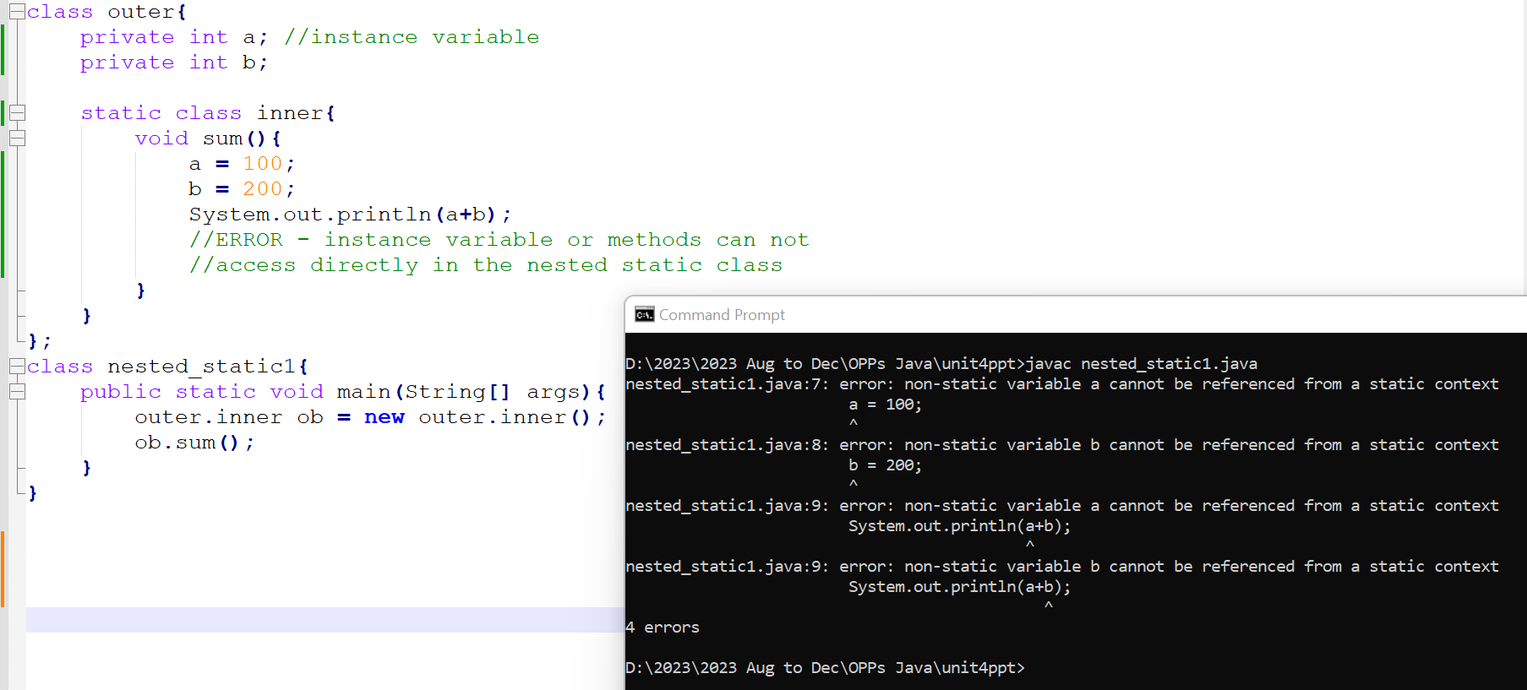
Supporting Example : A static nested class cannot refer directly to instance variables or methods defined in its enclosing class.

Slide 11
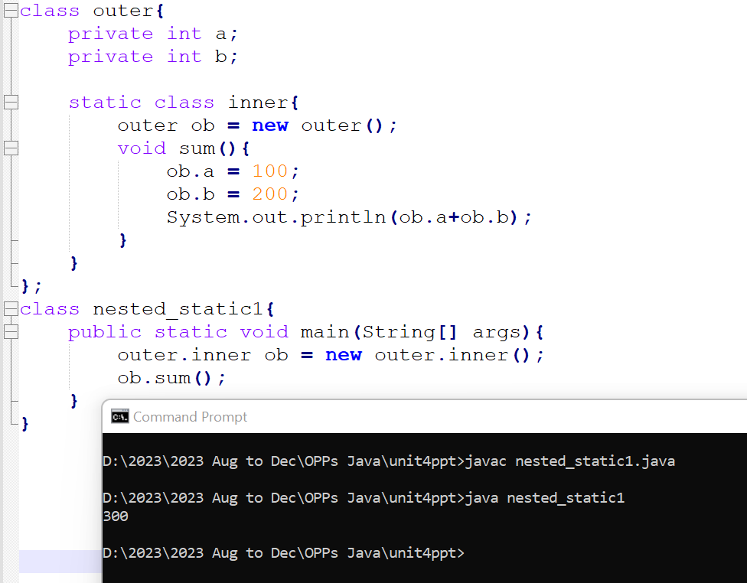
Supporting Example : It can use them only through an object reference.

Slide 12
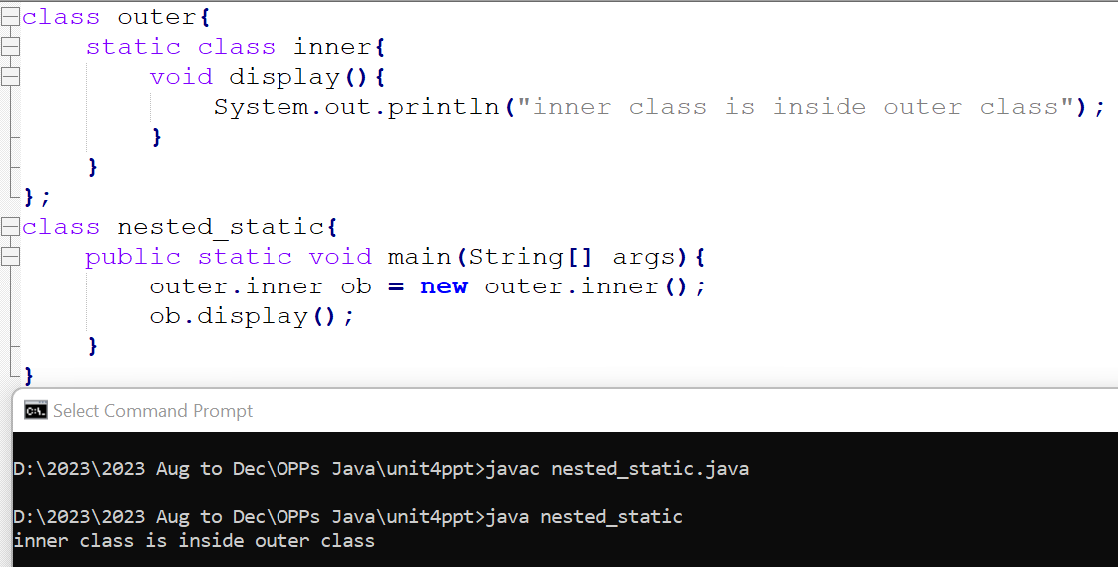

Slide 13
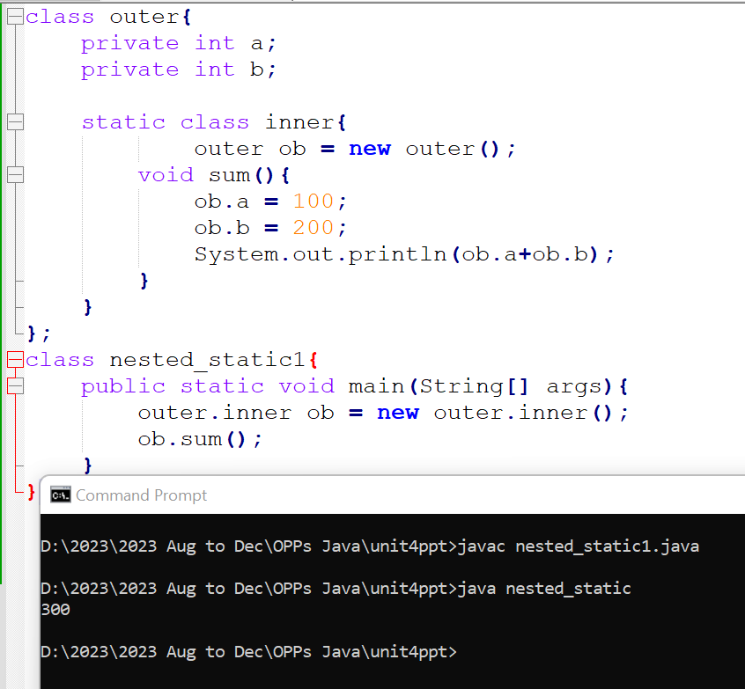

Slide 14
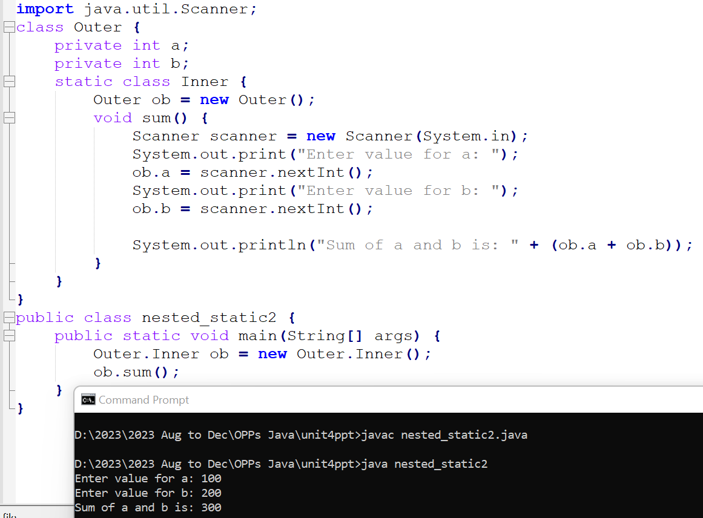

Slide 15
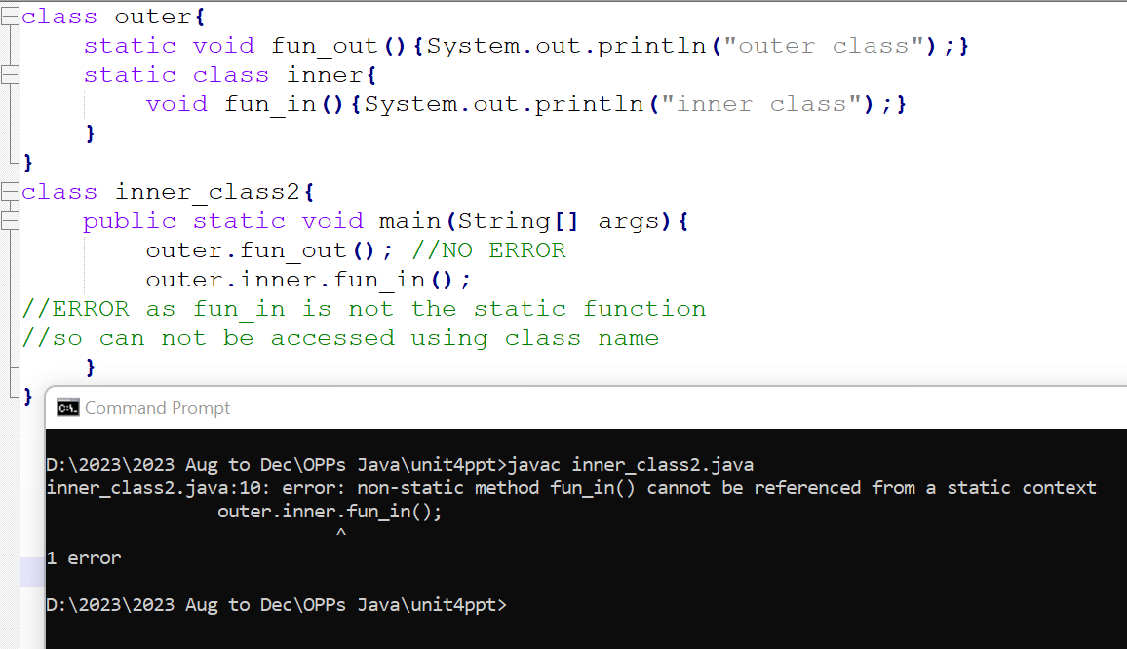

Slide 16
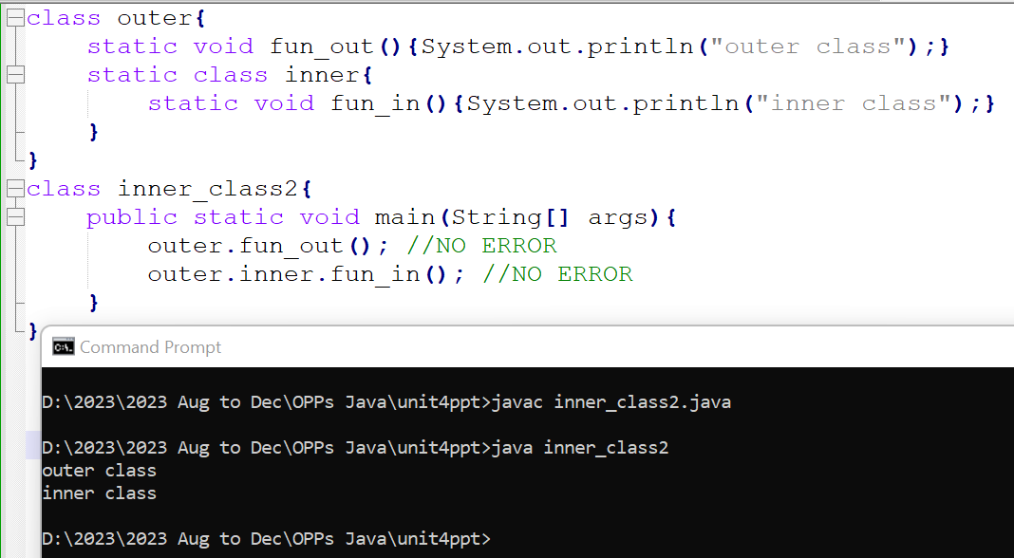

Slide 17
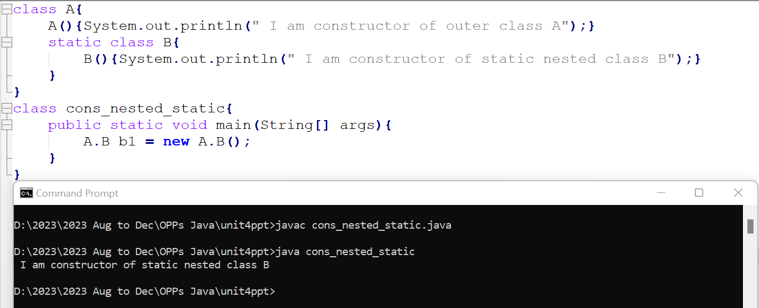
Note - By creating the object of the nested static class the constructor of outer class will not called automatically.

Slide 18
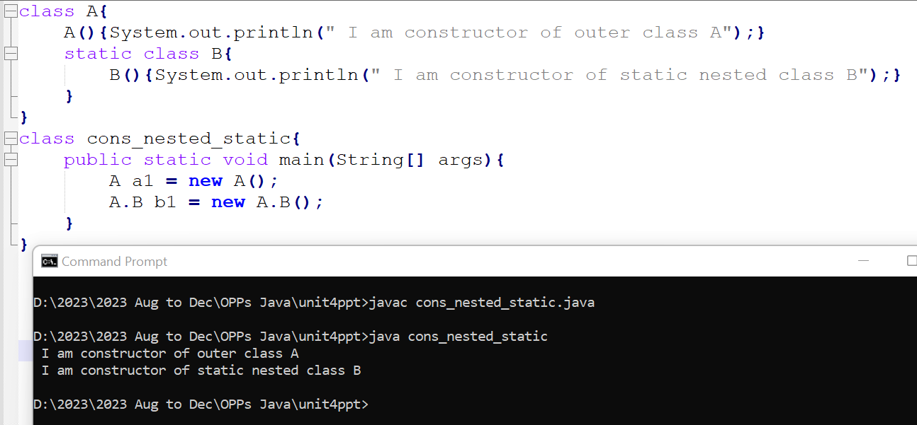
We have to explicitly create an object of the outer class to call the constructor of the outer class.

Slide 19
Inner Classes (non-static nested classes)
An inner class is associated with an instance of its enclosing class and has direct access to that object's methods and fields.
Because an inner class is associated with an instance, it cannot define any static members itself.
Consider the following classes:
class OuterClass {
...
class InnerClass { ... }
}

Slide 20
An instance of InnerClass can exist only within an instance of OuterClass and has direct access to the methods and fields of its enclosing instance.
To instantiate an inner class, we must first instantiate the outer class. Then, create the inner object within the outer object.
Syntax:
OuterClass.InnerClass innerObject = outerObject.new InnerClass();

Slide 21
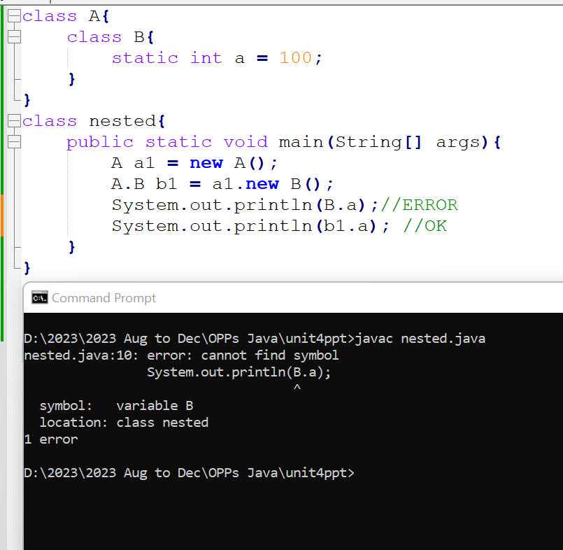
Supporting Example : Because an inner class is associated with an instance, it cannot define any static members itself.

Slide 22
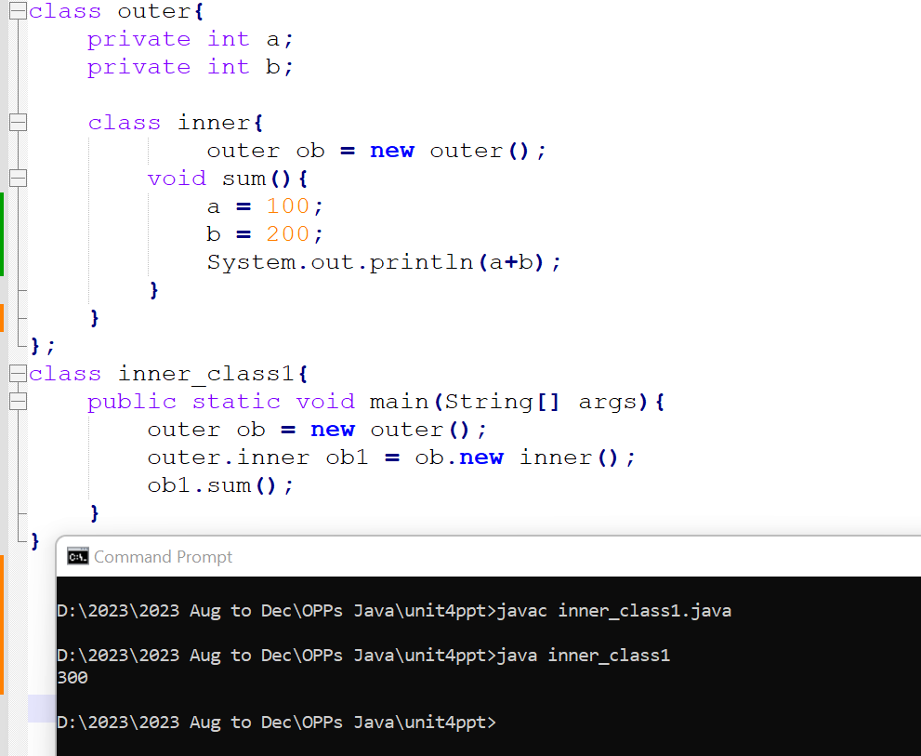
Supporting Example : An instance of InnerClass can exist only within an instance of OuterClass and has direct access to the methods and fields of its enclosing instance.

Slide 23
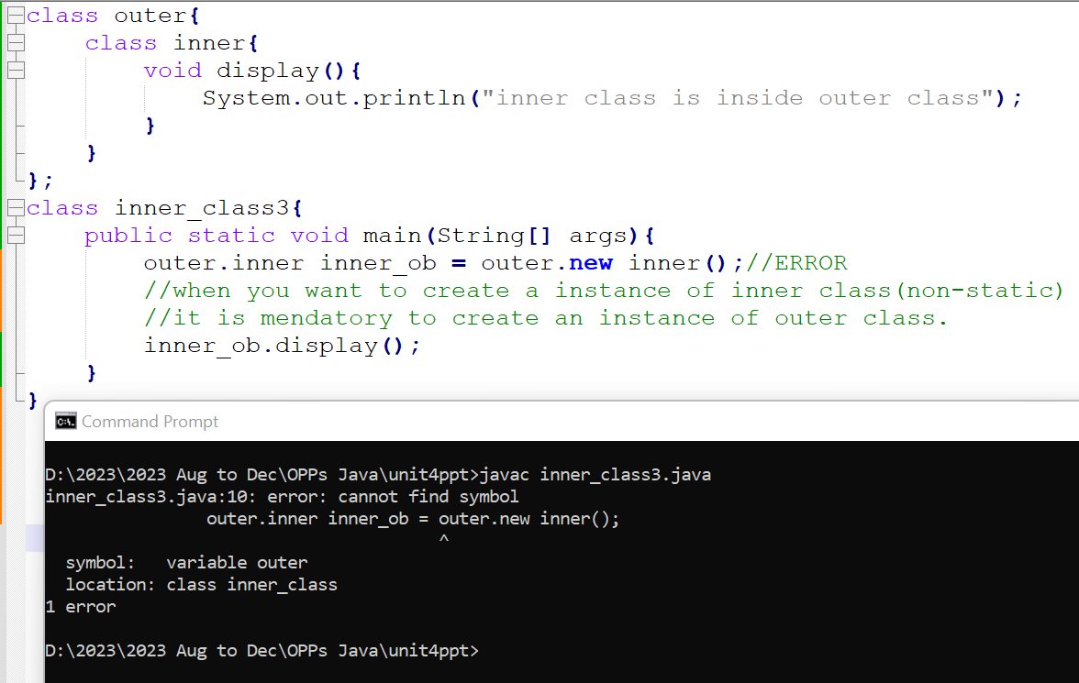
Supporting Example : To instantiate an inner class, we must first instantiate the outer class. Then, create the inner object within the outer object.

Slide 24
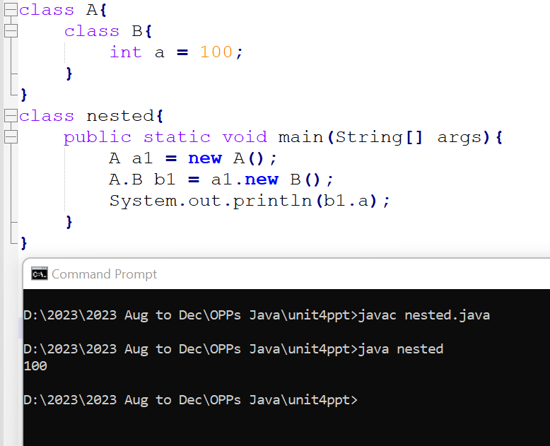

Slide 25
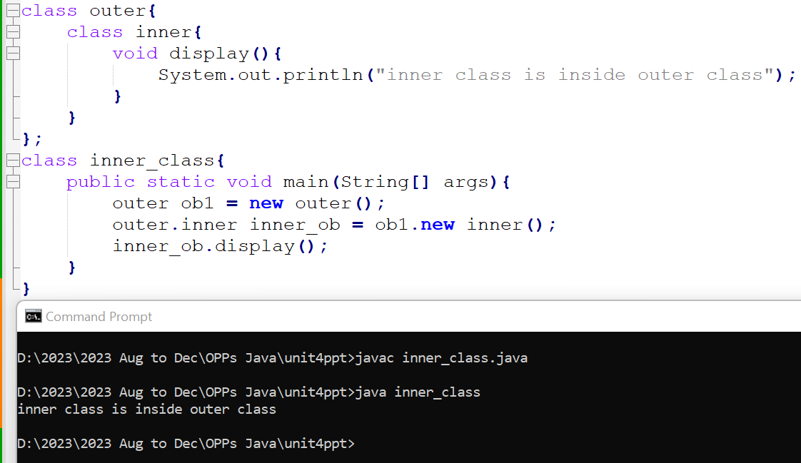

Slide 26
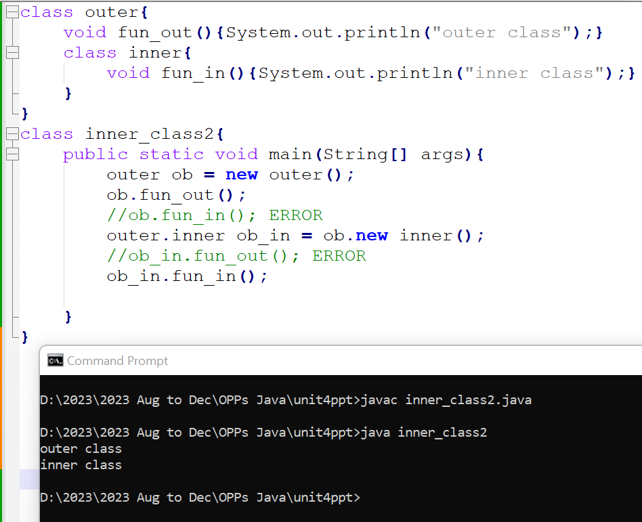

Slide 27
Classification of Inner classes
Additionally, there are two special kinds of inner classes:
local classes and
anonymous classes (also called anonymous inner classes).

Slide 28
Local Classes
Local classes are classes that are defined in a block, which is a group of zero or more statements between balanced braces.
For example, we can define a local class in a method body, a for loop, or an if clause.
A local class has access to the members of its enclosing class.
A local class has access to local variables. However, a local class can only access local variables that are effectively final or explicitly declared as final.

Slide 29
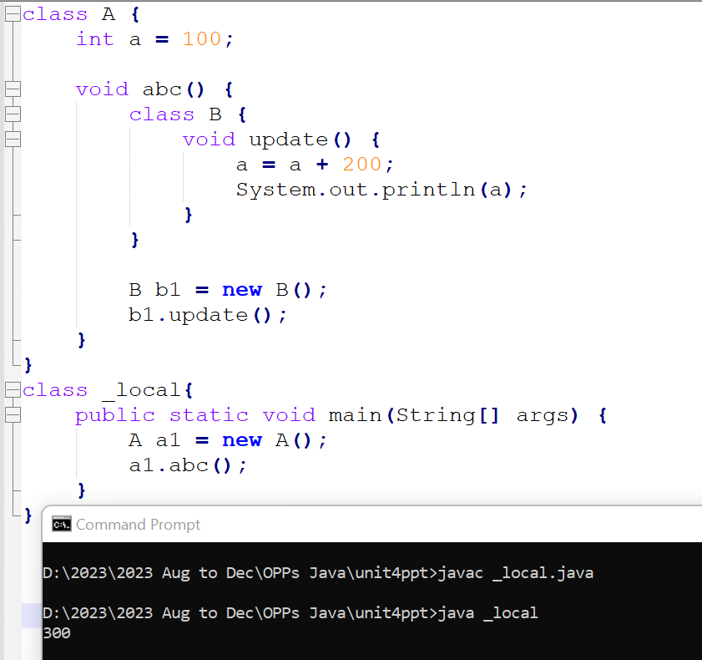
Example : A local class has access to the members of its enclosing class.

Slide 30
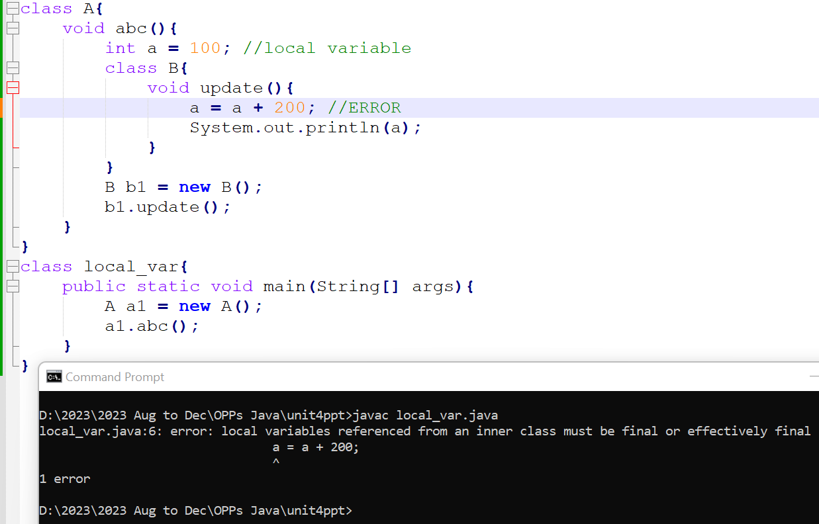
Example : A local class has access to local variables. However, a local class can only
access local variables that are effectively final or explicitly declared as final

Slide 31
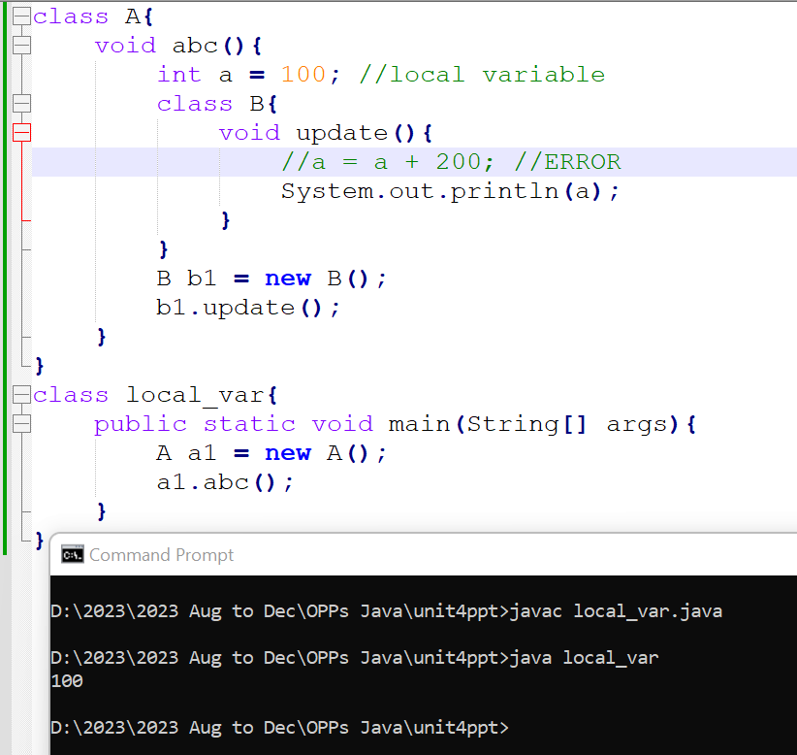
Corrected Example : A local class has access to local variables. However, a local class can only
access local variables that are effectively final or explicitly declared as final

Slide 32
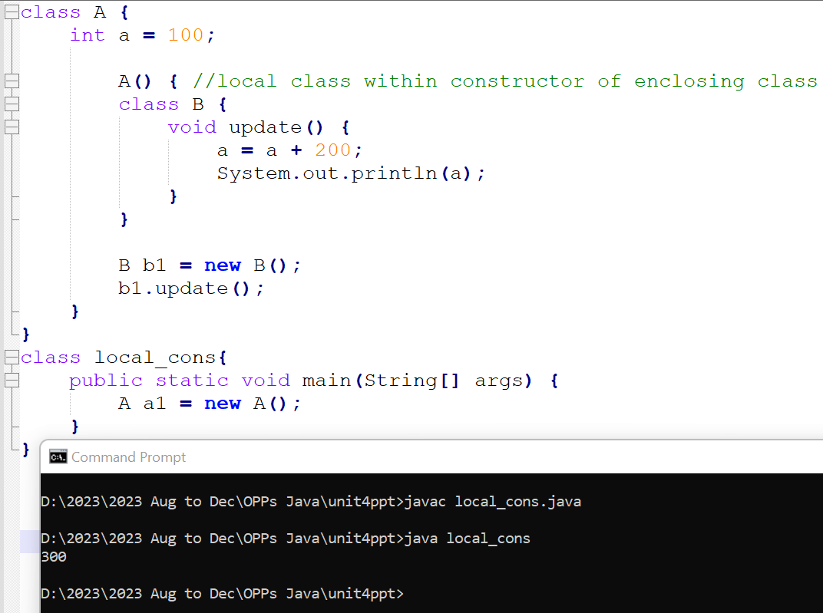
Example : Local class within the constructor of the enclosing class.

Slide 33
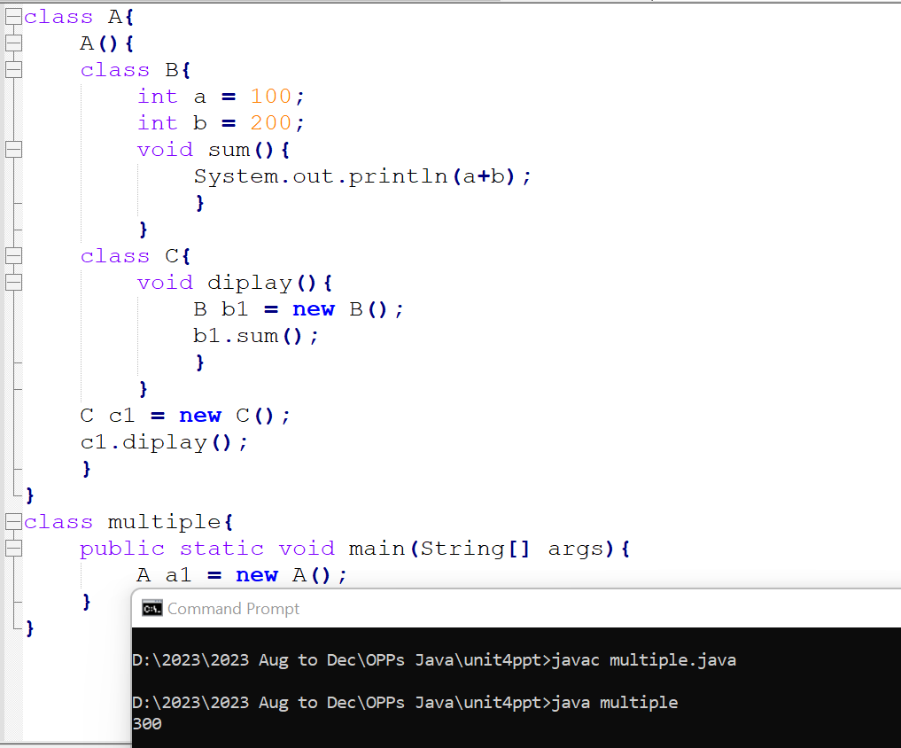
Example : Multiple local classes.

Slide 34
Anonymous Class

Slide 35
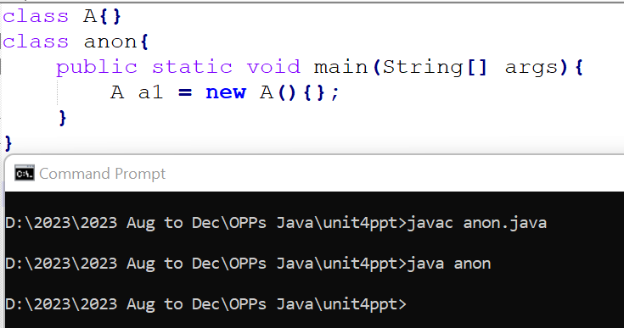
Anonymous Classes
Anonymous classes enable us to declare and instantiate a class at the same time.
Anonymous inner classes are often used when you need to override methods or implement interfaces, and you don't want to create a separate named class.

Slide 36
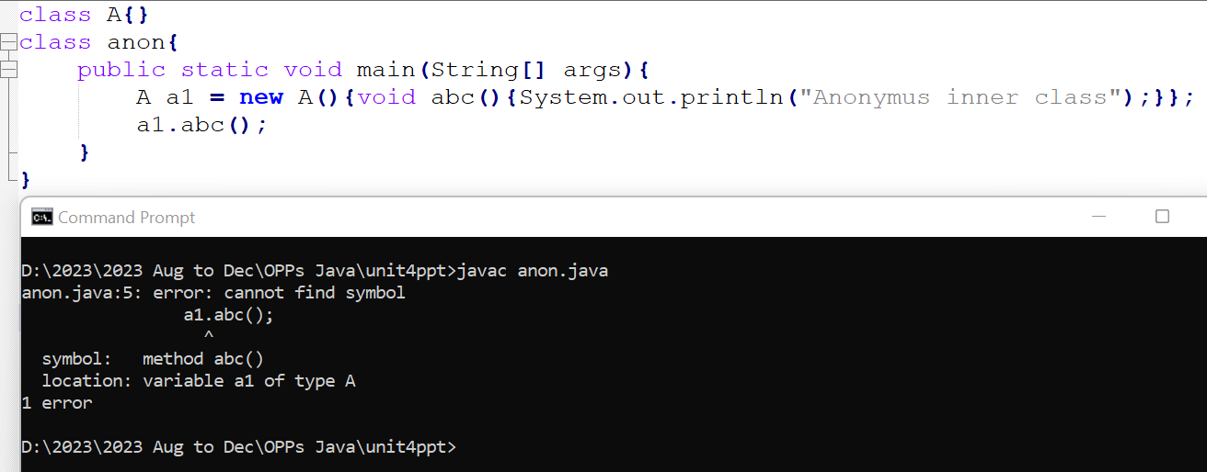
You can't add new methods to the anonymous inner class that is not already present in the base class that is Class A.

Slide 37
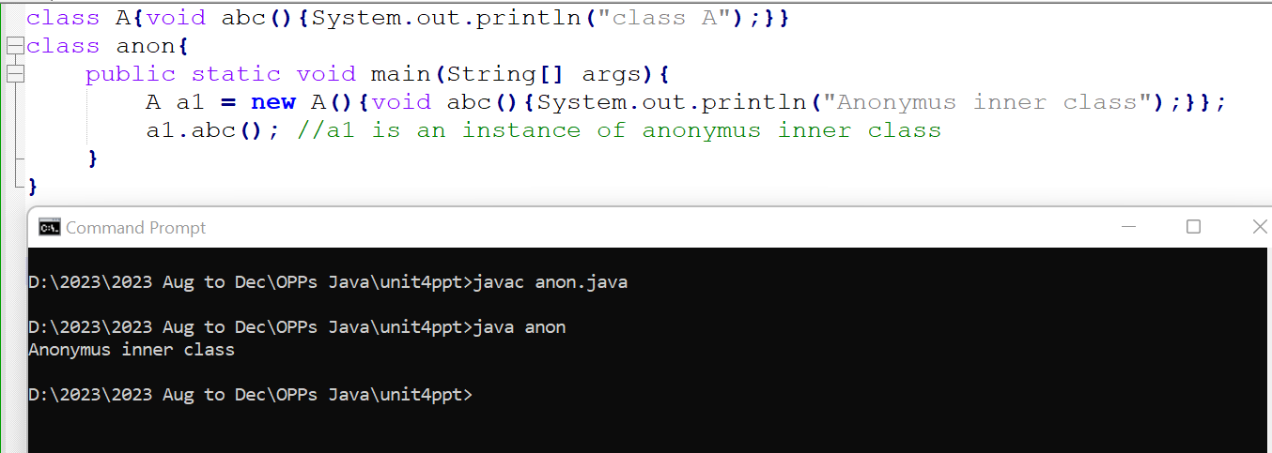
Corrected Example : You can't add new methods to the anonymous inner class that is not already present in the base class that is Class A.

Slide 38
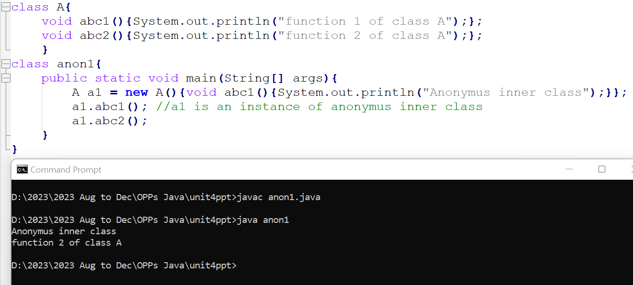
It is not mandatory to override all the functions of base class in anonymous inner class.

Slide 39
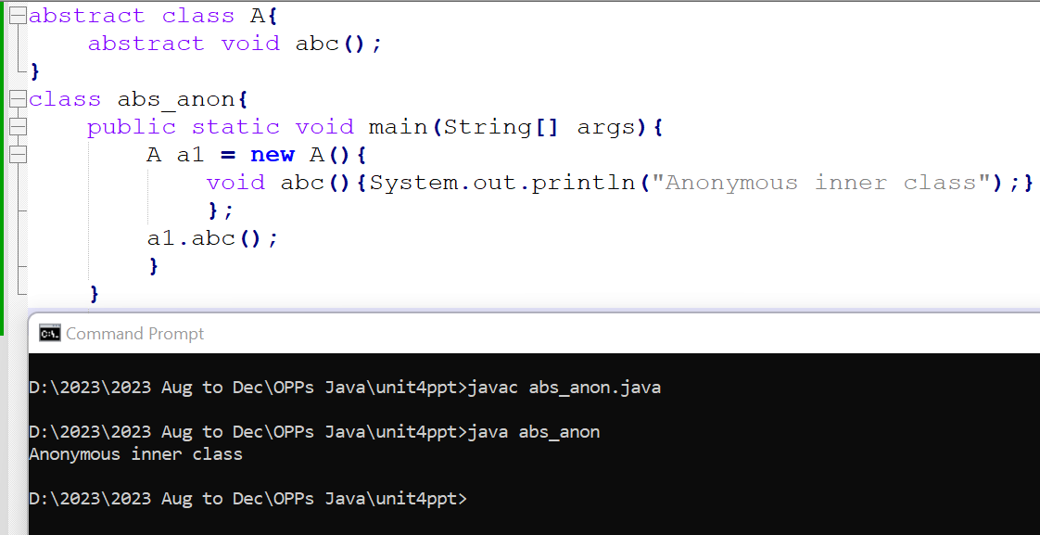
We can create anonymous inner class of an abstract class.

Slide 40
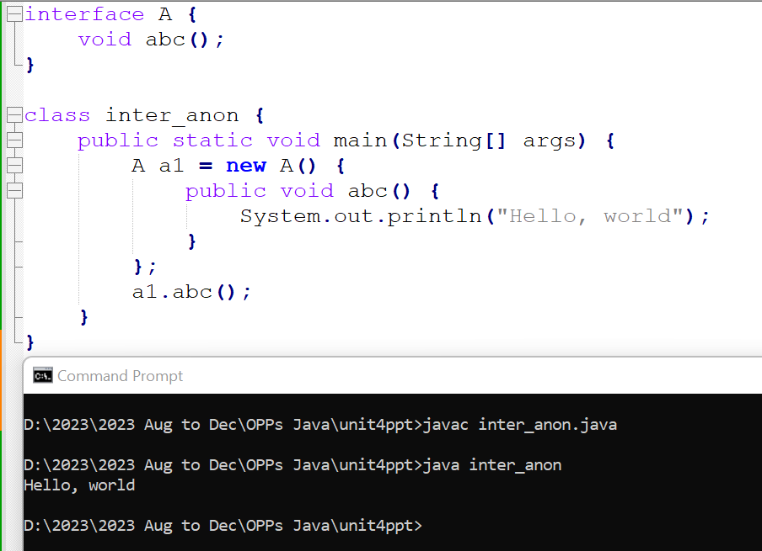
Anonymous inner class can implement interface.

Slide 41
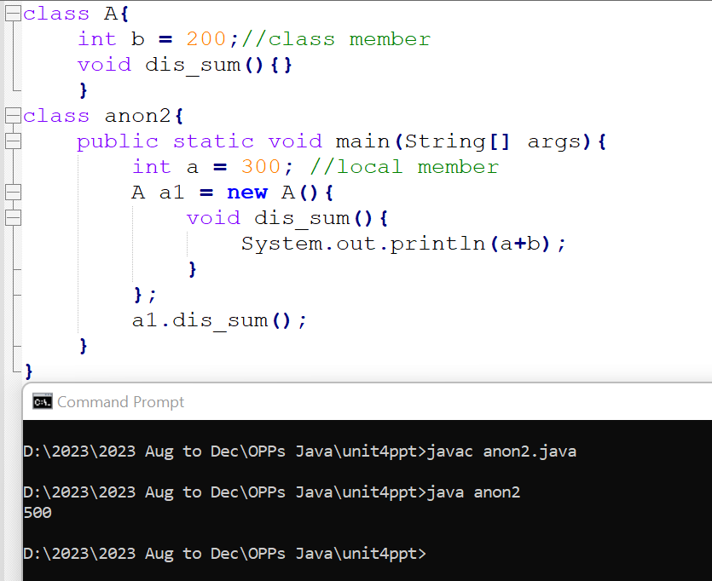
Example.

Slide 42
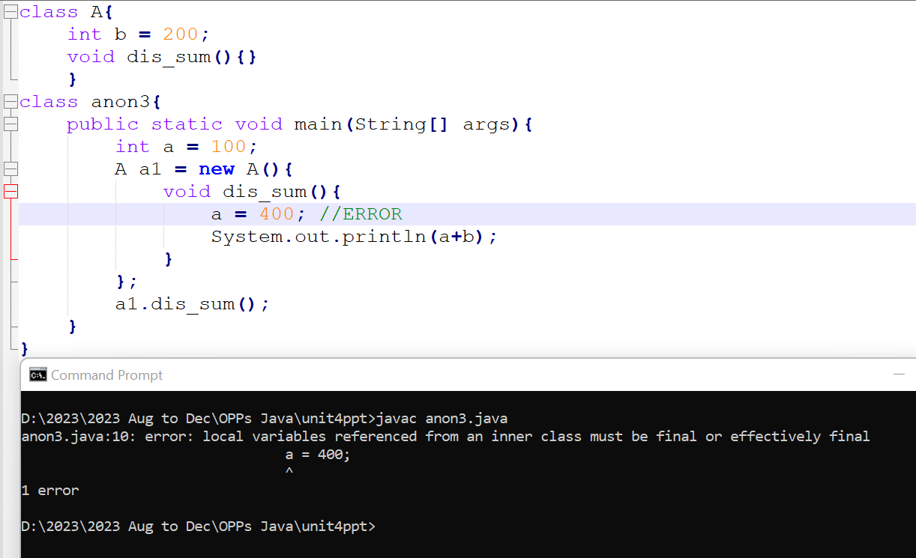
An anonymous class cannot access local variables in its enclosing scope that are not effectively final

Slide 43
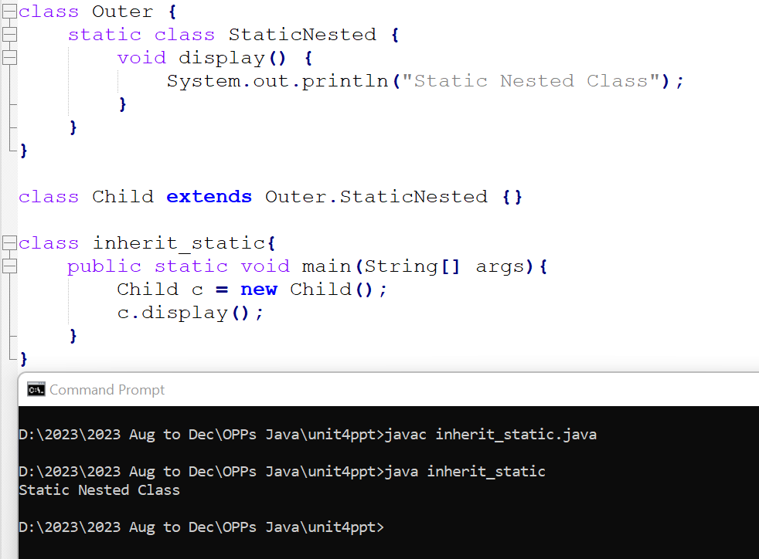
Inheriting static nested class

Slide 44
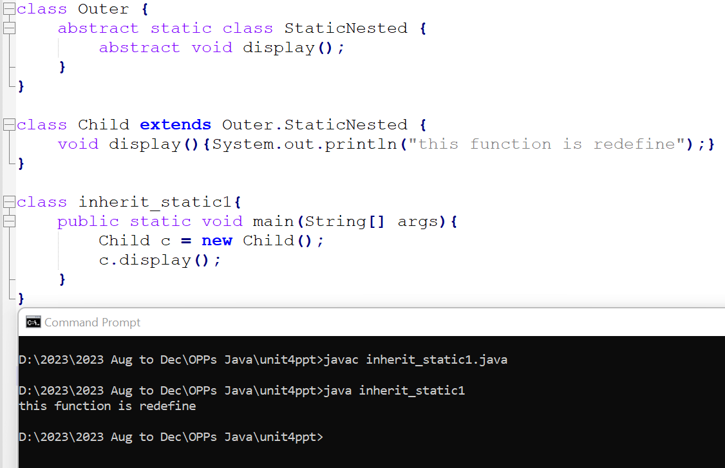

Slide 45
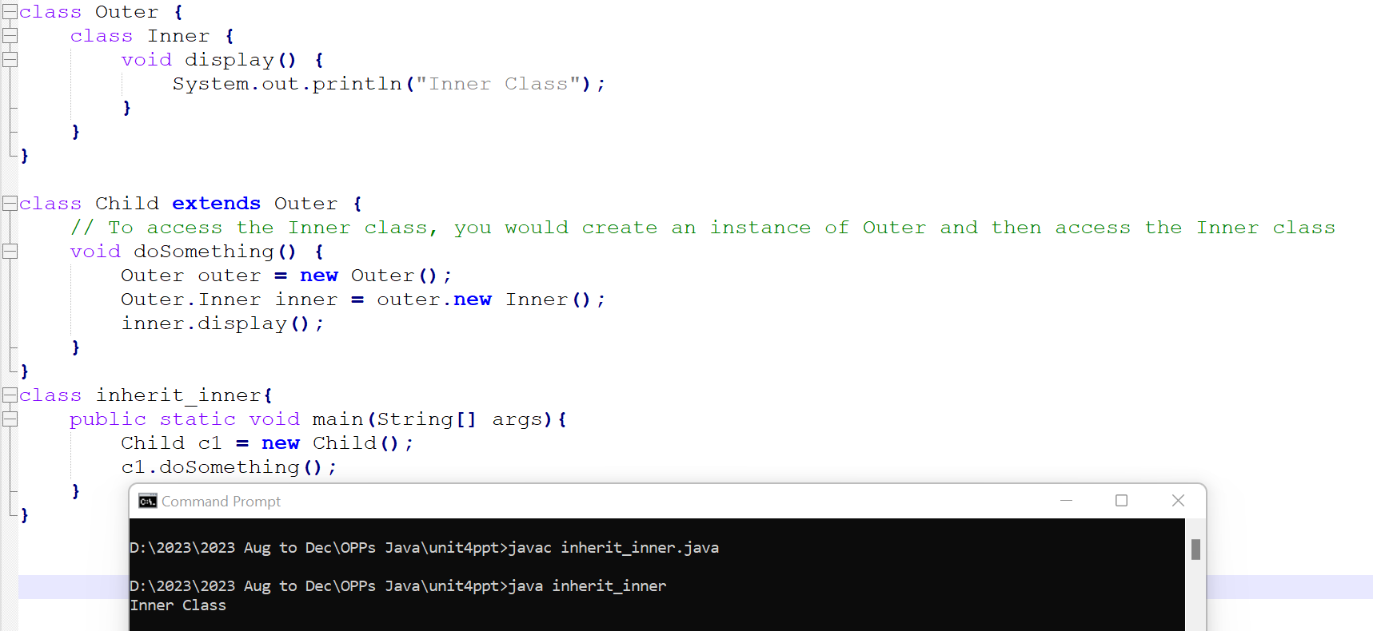
Inheriting inner(non-static) class

Slide 46
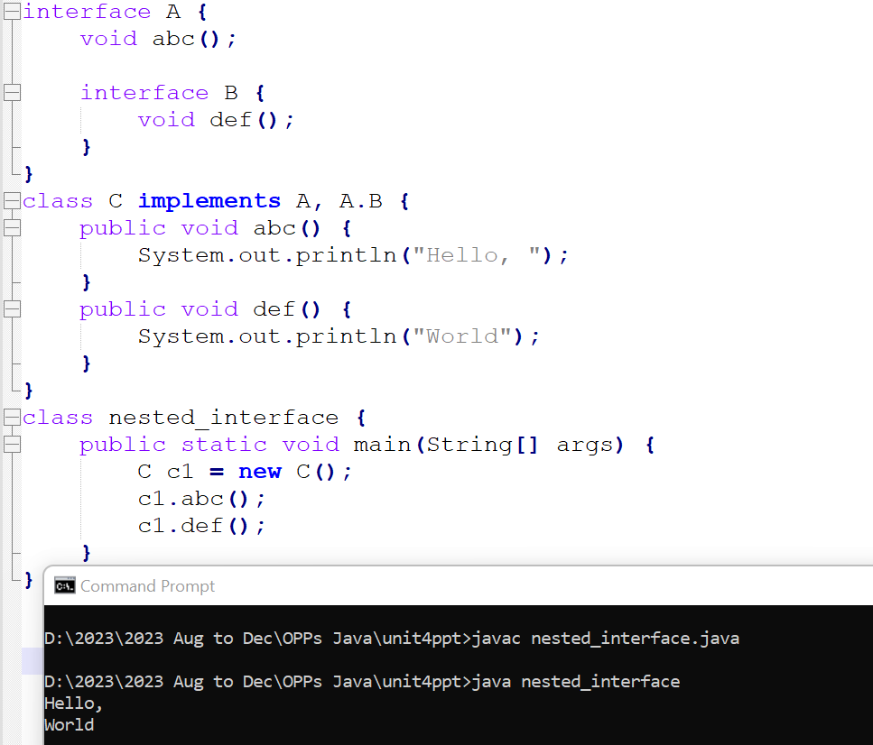
Nesting Interfaces

